Slide 1

Group Project
----For ERG3010
Group members: 王沿朴 Yanpu Wang 118010308
汪启元 Qiyuan Wang118010298
郑舜日 Shunri Zheng118010445
丘靖瑜 Jingyu Qiu118010248

Slide 2
01
Problem analysis & methods chosen
02
Data base building
Outline
03
Data processing
04
Exhibition
Notes:
1、了解数据 2、分析问题 3、根据建表需要清洗数据 4、Apply statistical methods to the cleaned data.

Slide 3
01
Problem analysis & methods chosen

Slide 4
01
Problem analysis & methods chosen
Three Problems:
1. To get the year for every state in US when the largest number of bridges were built in that state.
Notes:
介绍问题

Slide 5
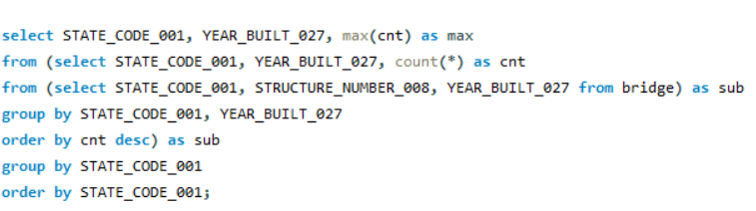
01
Problem analysis & methods chosen
Methods of analyses
For question 1:
Notes:
介绍问题

Slide 6
01
Problem analysis & methods chosen
Three Problems:
2. To find out the main factors about bridges’ maintenance/improvement cost, and prove it with information derived from DB quantitatively.
3. To find out the main factors about the average daily traffic, and prove it with information derived from DB quantitatively.
Narrow down the range of attributes
Build up relationships between the attributes and form entities
Build up the DB and clean data
Apply statistical method to analysis
Notes:
介绍问题

Slide 7

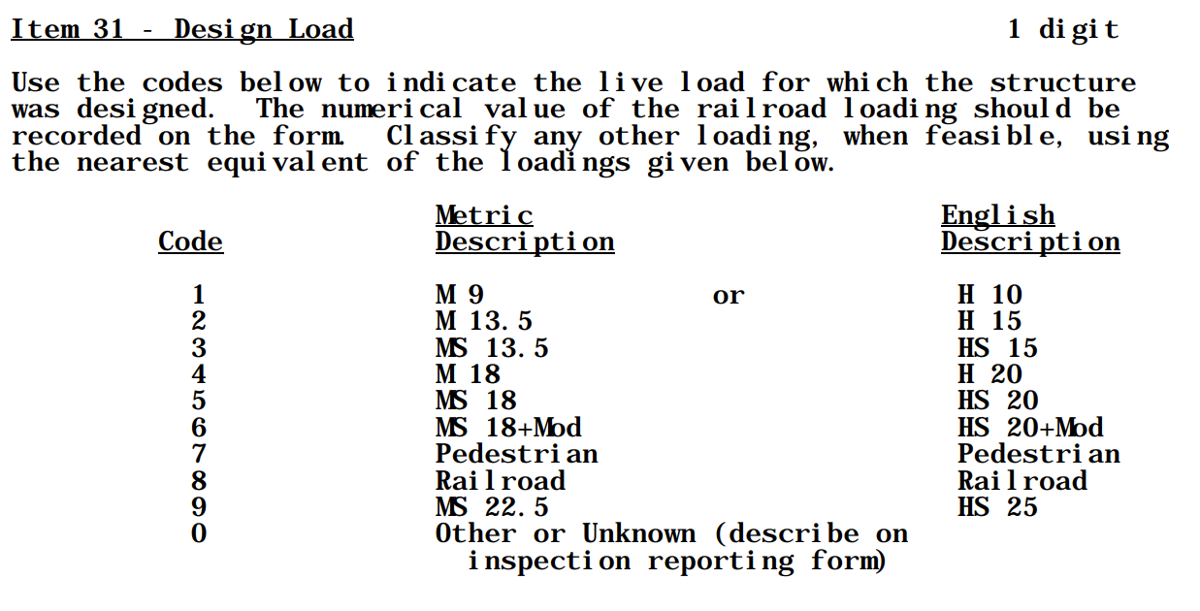
01
Problem analysis & methods chosen
Attributes analysis
Notes:
介绍问题

Slide 8
01
Problem analysis & methods chosen
Attributes analysis
Four main regions for the attributes:
1. The main features of the bridges
2. Relevant objects of bridge maintenance/improvement
3. The main features of the lanes built on the bridges.
4. Relevant objects of Traffic.
Notes:
介绍问题

Slide 9
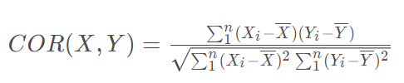
01
Problem analysis & methods chosen
Methods of analyses
For question 2&3:
Variances of the mean values under different categories
Categorical
Data type of the attributes
Quantitative
Notes:
介绍问题

Slide 10
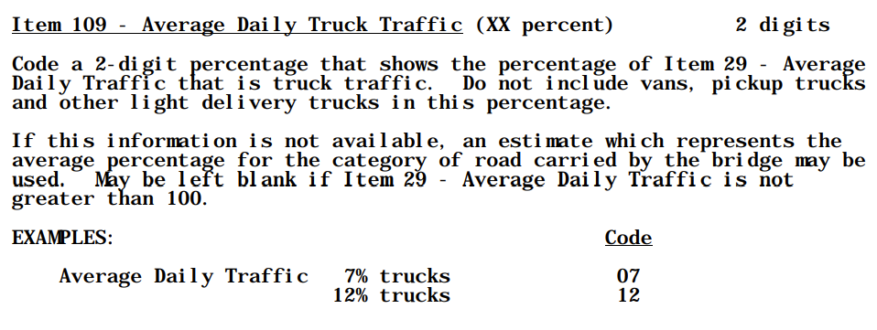
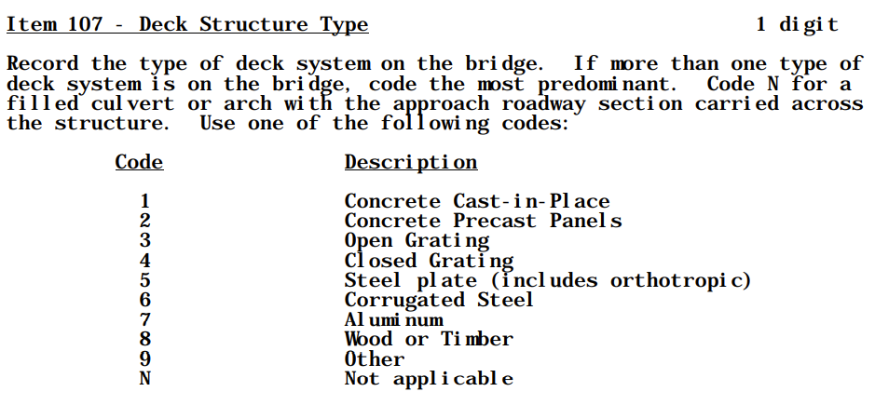
01
Problem analysis & methods chosen
Methods of analyses
Quantitative
Categorical
Notes:
介绍问题

Slide 11
01
Problem analysis & methods chosen
Methods of analyses
For question 2&3:
Variances of the mean values under different categories
Categorical
Data type of the attributes
Quantitative
Notes:
介绍问题

Slide 12
02
Database building

Slide 13
What exactly is a record in the original data describing?
Bridge
Route on the bridge
Route under the bridge
Traffic
Inspection
&
maintenance

Slide 14
02
Design concept:
What kind of event does an original record describe?
BRIDGE_INFO
INVENTORY_ROUTE
The characteristics and basic properties of Bridges
The characteristics and basic properties of Roads
BRIDGE_INSPECT
TRAFFIC
02
How Bridges were
maintained and improved
The traffic condition
of the Roads

Slide 15
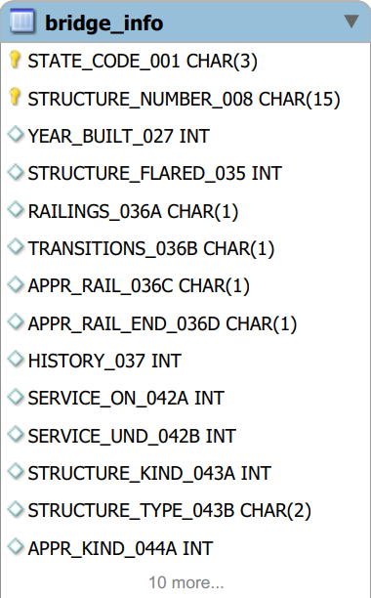
02
BRIDGE_INFO
The properties of the Bridge itself are recorded in this table.
These properties describe the basic characteristics of the bridge
and do not change as records are updated.
Composite Primary Key:
STATE_CODE_001 + STRUCTURE_NUMBER_008
“The structure number must be unique for each bridge within the State.” —Guidebook item 8
The combination of the two can uniquely identify a bridge
instance without duplication.
Other Attributes:
i.e. : SRUCTURE_KIND_043A & STRUCTURE_TYPE_043B
These attributes are basic characteristics of the bridge and almost never change as maintenance records are updated

Slide 16
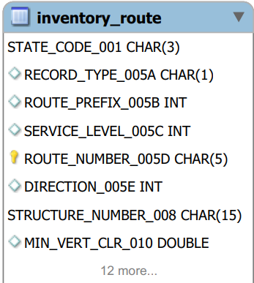
02
INVENTORY_ROUTE
The properties of the Road itself are recorded in this table.
These properties describe the basic characteristics of the bridge
and do not change as records are updated.
Composite Primary Key:
STATE_CODE_001+STRUCTURE_NUMBER_008+ROUTE_NUMBER_005D
The combination of the three uniquely identified
a road instance without duplication.
1:M relationship between BRIDGE_INFO & INVENTORY_ROUTE:
A bridge can be associated with multiple roads,
such as the road above the bridge and the road below the bridge.
However, each road can only correspond to one bridge.
Other Attributes:
i.e. : DIRECTION_005E
These attributes are basic characteristics of the bridge
and almost never change as maintenance records are updated

Slide 17
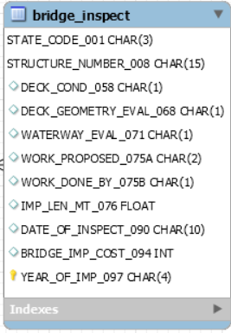
02
BRIDGE_INSPECT
This table records the previous improvements to the bridge and the assessment of the level of maintenance.
Composite Primary Key:
STATE_CODE_001+STRUCTURE_NUMBER_008+YEAR_OF_IMP_097
The combination of the three uniquely identified
a record of the improvement or damage assessment of a bridge.
1:M relationship between BRIDGE_INFO & BRIDGE_INSPECT:
A bridge can have multiple maintenance records though out years,
However, each record can only correspond to one bridge instance.
Other Attributes:
i.e. : DECK_COND_058, DECK_GEOMETRY_EVAL_068
These attributes describe the assessment level of damage of
the bridge.

Slide 18
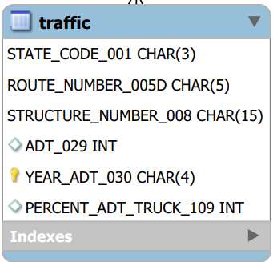
02
TRAFFIC
This table records the traffic on each road
Composite Primary Key:
STATE_CODE_001+STRUCTURE_NUMBER_008+ROUTE_NUMBER_005D+YEAR_ADT_030
The combination of the four uniquely identified
a record of the traffic condition of a road in a particular year.
1:M relationship between INVENTORY_ROUTE & TRAFFIC:
Each road can have a different record of traffic from year to year
However, each record can only correspond to one road instance.
Other Attributes:
i.e. : ADT_029 &PERCENT_ADT_TRUCK_109
These attributes describe These attributes describe the average daily traffic flow of
each road in a given year and the proportion of the average number of trucks
in the average daily traffic flow.

Slide 19
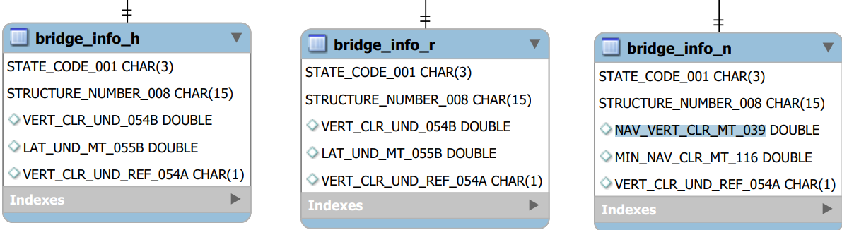
02
Discriminator
This discriminator distinguishes three different types of Bridges:
Bridges built on highways, Bridges built on railways and Bridges built on water
Composite Primary Key:
STATE_CODE_001+STRUCTURE_NUMBER_008
Type discriminator: VERT_CLR_UND_REF_054A (“H”,”R”, ”N”)
1:1 relationship between BRIDGE_INFO & BRIDGE_INFO_H (R/N):
Each subclass inherits attributes from its parent class and corresponds to its own record in the parent class.
The corresponding record in each parent class corresponds to only one record in each child class.
Other Attributes:
i.e. :VERT_CLR_UND_054B for “H” & “R”
NAV_VERT_CLR_MT_039 for “N”

Slide 20
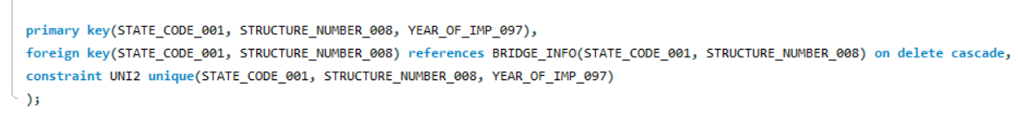
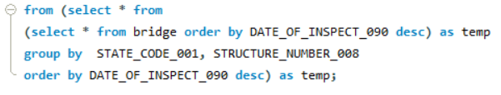
Processing of foreign keys and primary keys
i.e.: BRIDGE_INSPECT
Foreign keys: STATE_CODE_001, STRUCTURE_NUMBER_008
Filter records with duplicate primary key values
i.e.: BRIDGE: solve the problem at the data insertion state:

Slide 21
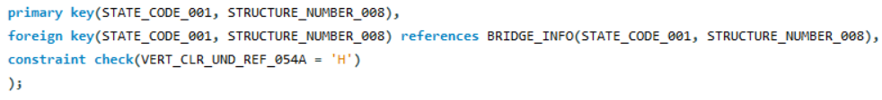
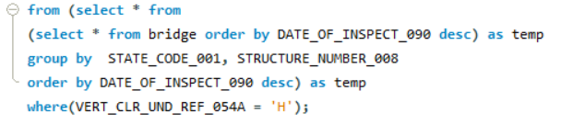
Implement the discriminator
i.e.: BRIDGE_INFO_H

Slide 22
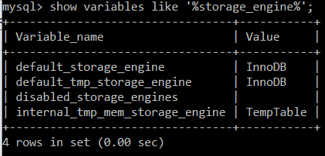
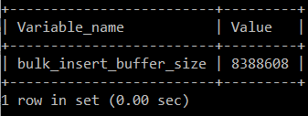
Database optimization
Set default storage engine as InnoDB, using B-Tree to select instance.
mysql> set session bulk_insert_buffer_size = 1024 * 1024 * 1;

Slide 23
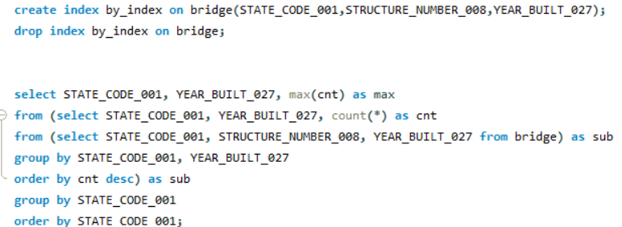
Database optimization
Create index for high dimensional attributes
and attributes used in “group by”, “order by” operations
Before using index
After using index

Slide 24
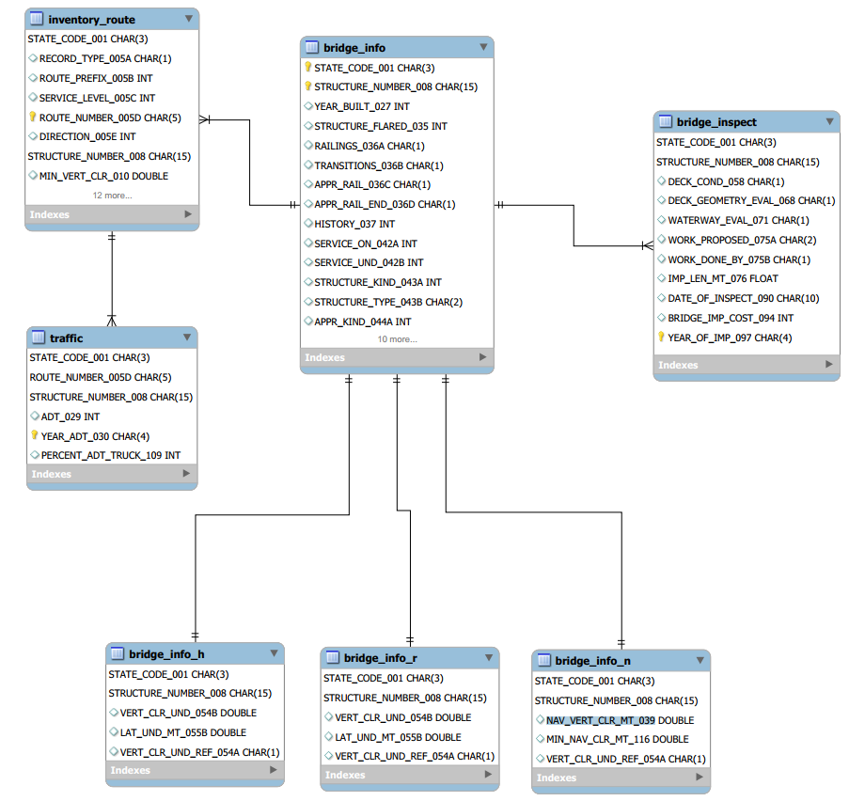

Slide 25
03
Data Processing

Slide 26
03
Data Processing
When we are building up the database:
For “DATE_OF_INSPECT_090” We convert this column into date time:
E.g., “1214” stands for “December 2014”, we convert it into “2014-12-00” so that in future inquires we can order data by date.
For data integrity and consistency with the guidebook,
For columns like “STRUCTURE_NUMBER_008”, We replace all the ‘-’ with 0 and fill them to 15 digits so that their formats fit the description in the guidebook.
点击此处添加标题
E.g., for “--------3633632” in “STRUCTURE_NUMBER_008”, , we will convert this column into “000000003633632”.

Slide 27

03
Data Processing
When we are analyzing the data for our research questions:
We found that there exist some characters having explainable meanings.
E.g., according to the guidebook, the N in “SCOUR_CRITICAL_113” means the bridge is under the water. It means that the bridge is under very dangerous conditions. Therefore, we changed the ‘N’ into 12.
点击此处添加标题

Slide 28
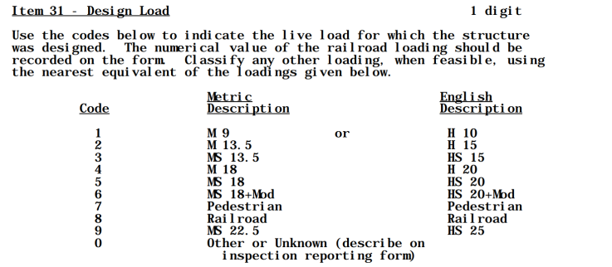
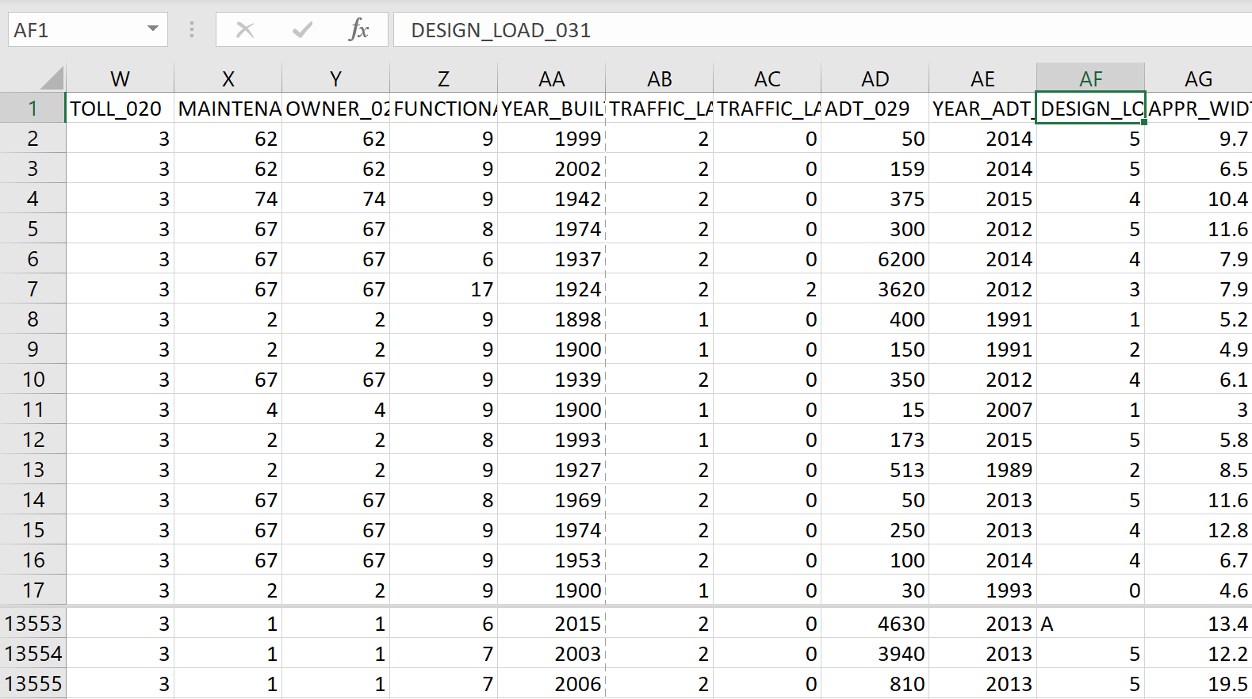
03
Data Processing
When we are analyzing the data for our research questions:
We found that there exists some unexplainable records.
E.g., according to the guidebook, the value of “DESIGN_LOAD_031” should be nothing but an integer falls into 0-9. However, we found values like ‘A’, ‘B’ and ‘C’ in this column. This kind of abnormal values would interfere calculating Average Value or Pearson Correlation Coefficient.

Slide 29
03
Data Processing
When we are analyzing the data for our research questions:
To avoid these kinds of problem, we first categorize columns in our dataset:
For data under “RAILINGS_036A”, “TRANSITIONS_036B”, “APPR_RAIL_036C”, “APPR_RAIL_END_036D”, “SURFACE_TYPE_108A”, “DESIGN_LOAD_031”, “DECK_COND_058”, “SUPERSTRUCTURE_COND_059”, “DECK_GEOMETRY_EVAL_068”, “UNDCLRENCE_EVAL_069”, “DECK_STRUCTURE_TYPE_107” or “SCOUR_CRITICAL_113”
We would replace the data with the corresponding values. We would convert ‘N’ into ‘1’, ‘-1’ or ‘2’ correspondingly.

Slide 30
03
Data Processing
When we are analyzing the data for our research questions:
To avoid this kind of problem, we first categorize columns in our dataset:
After that, we can extract all values by regular expression. We extract all non-character values with ‘([^a-zA-Z]+)’.
Finally, we can fill NULL with average value of existing records of each column.

Slide 31
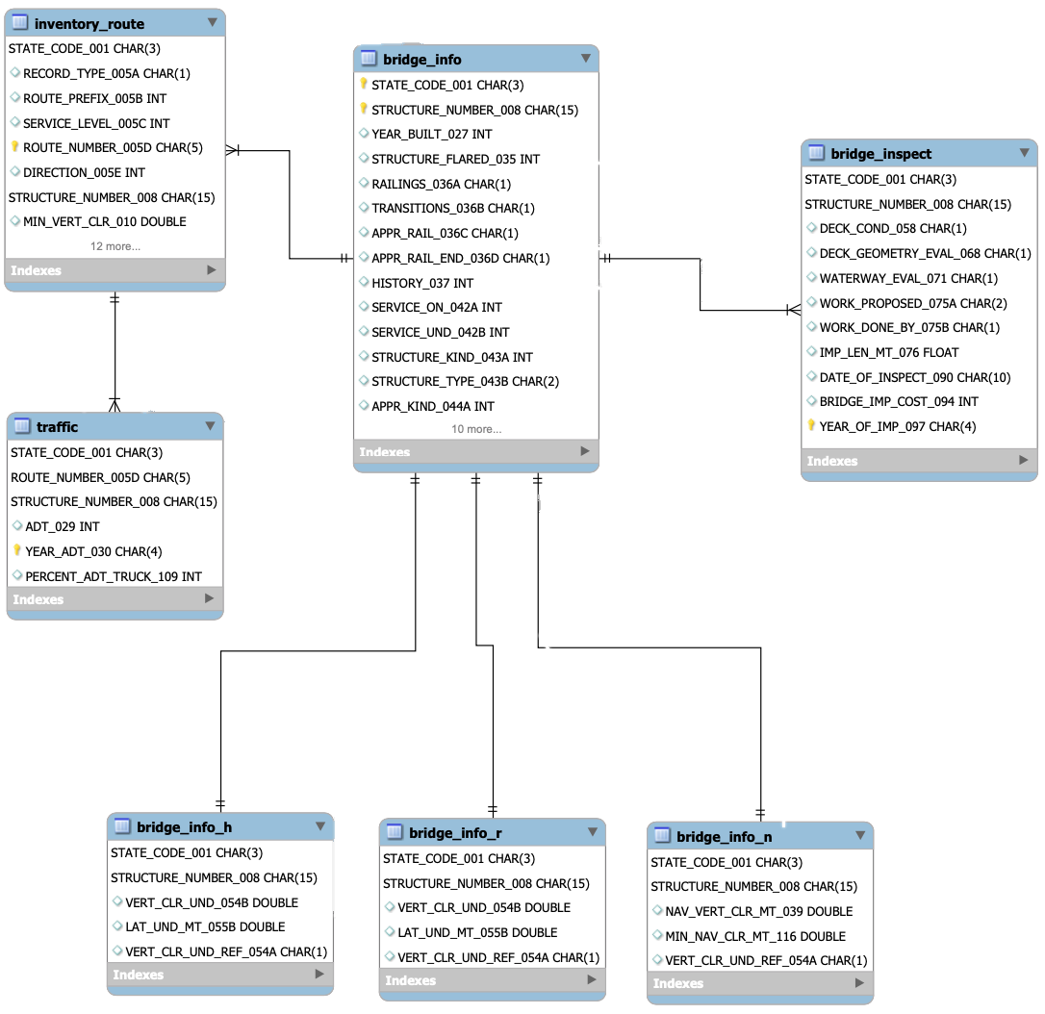
ERD
bridge_info
Basic bridge properties
bridge_inspect
Inspection data with inspecting date
inventory_route
Route information
traffic
Traffic information with observation year

Slide 32
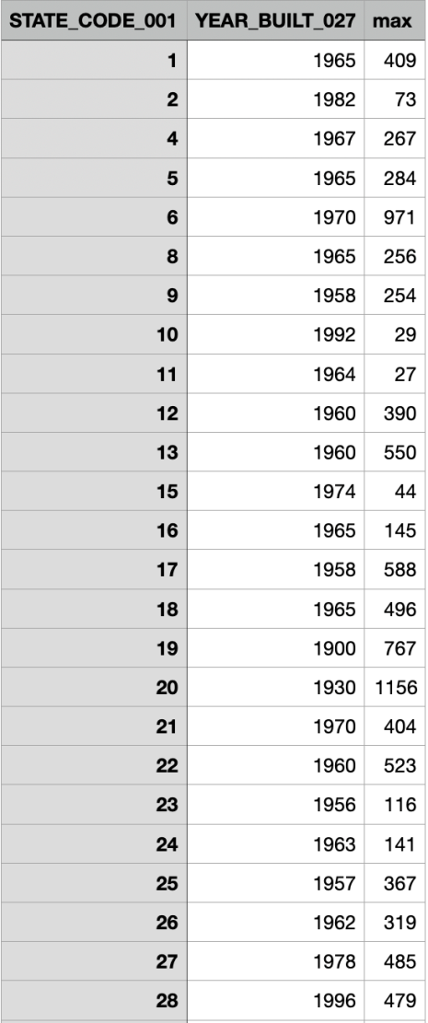
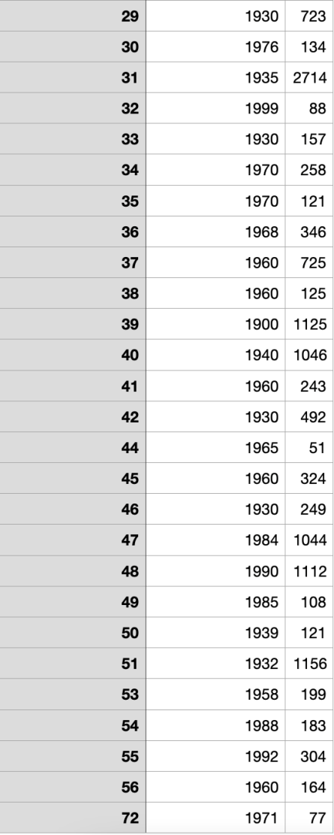
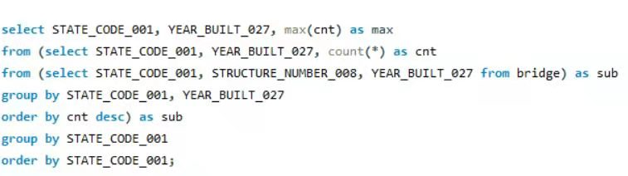
Question 1
To get the year for every state in US when the largest number of bridges were built in that state.

Slide 33
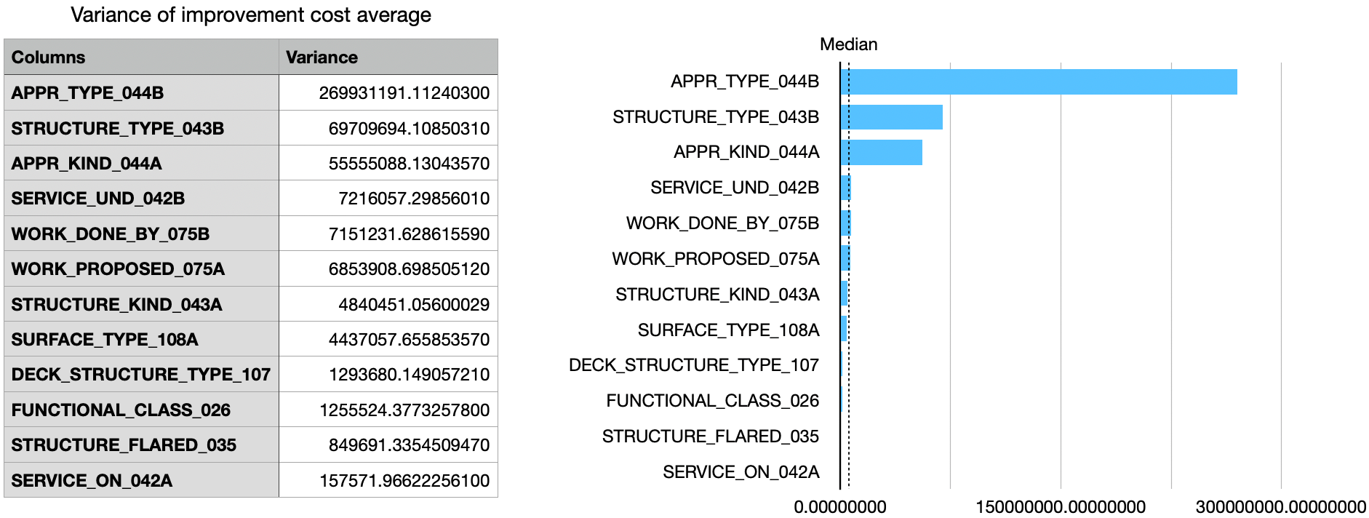
Question 2 categorical attributes
Most significant factors to improvement cost
Approach structure
Bridge structure
Approach building material

Slide 34
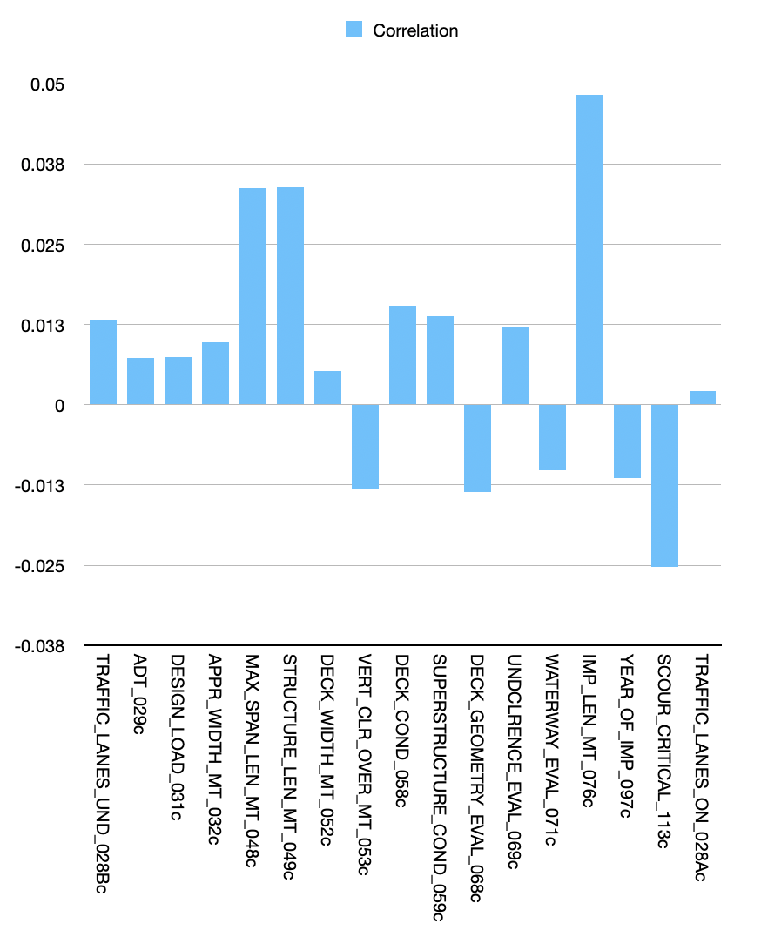
Question 2 quantitative attributes
Direct proportional factors
Improvement length
Bridge length
Bridge width
Inverse proportional factors
Scour situation
Deck lanes evaluation

Slide 35
Question 3 categorical attributes
Most significant factors to ADT
Available direction of traffic
Functional class (inter-state, local…)
Service level (highway, railroad)
Within national network

Slide 36
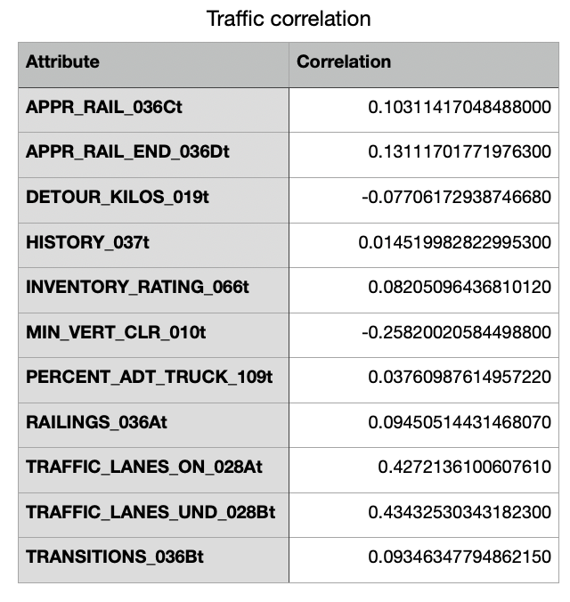
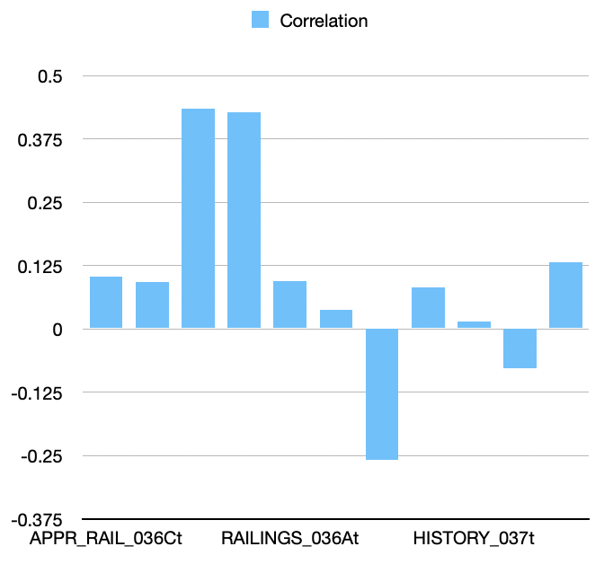
Question 3 quantitative attributes
Direct proportional factors
Inverse proportional factors
Detour length
Historical importance
Truck percentage

Slide 37
THANKS FOR LISTENING

